Slide 1


Slide 2
Power Market Survey (PMS )
Model Over View

Slide 3
Steps For Data Validation For Each DISCO
Activities Regarding Base Year
Matching Category-wise and Total Sale
Matching 11 kV Received By Adding Distribution Losses
Matching 132 kV Received By Adding Transmission Losses (It means Matching Sent out of each DISCO)
Match Grid Stations By Matching Actual Peak Demand of each Grid
Match the Base year Sale with unserved energy (Load Shedding)
Matching Recorded And Computed Demand of Each DISCO
Pending Load Validation Check

Slide 4
Explanation For Matching 11 kV Received By Adding Distribution Losses

Slide 5
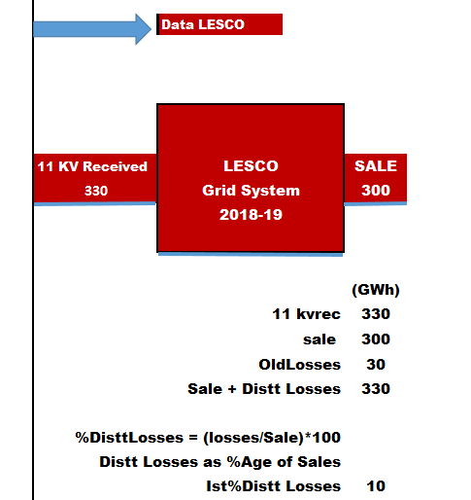

Slide 6
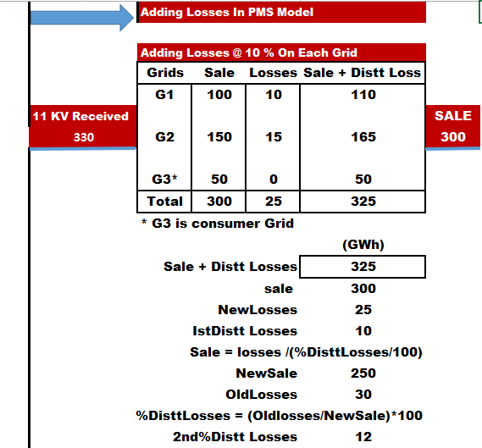

Slide 7
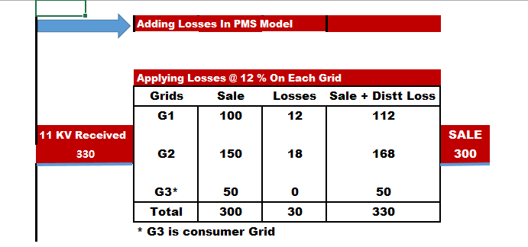

Slide 8
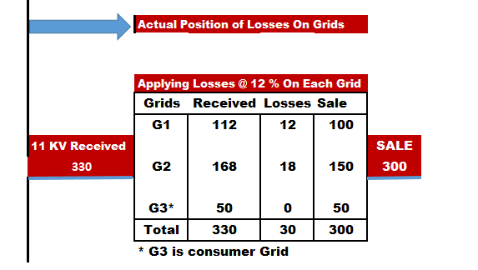

Slide 9
DISCO Reports
Forecast without incorporating Load Shedding effect (Low Forecast)
Computed Forecast (Base Forecast)
Monthly Peak Demand Forecast (Base Forecast)
Consumer Category Wise Sale – GWh without incorporating Load Shedding effect (Low Forecast)
Consumer Category Wise Sale – GWh (Base Forecast)
Consumer Category Wise Demand – MW without incorporating Load Shedding effect (Low Forecast)
Consumer Category Wise Demand – MW (Base Forecast)
Division-wise Sale (GWh), Generation (GWh) and Demand (MW) Forecast
District-wise Sale (GWh), Generation (GWh) and Demand (MW) Forecast
List of Overloaded Substations during Period 2015-16 to 2025-26 Overloading Criterion= Optional 85% etc…
List of Overloaded Substations during Forecast Period ( Overloading Criterion=100%. Or as Selected)
List of Grids with their Codes and MVA Capacities
Maximum Demand (MW) of Substations (Base Forecast)
Family of Grids (Existing, Proposed & Transit Grid)
Category-wise Energy (KWh) and Maximum Demand (KW) of Substations for Year 2025-26 (Last year of the forecast period)(Base Forecast)

Slide 10
System Reports

Slide 11
Uses of PMS IN DISCOs
Planning
Future capacity requirements
Overloading of transformers
Disaggregated Capacity Requirements (can identify the location of new substation)
Operation
Peak Demand Management
Resource allocation
Quantum of Load Shedding in future energy and demand
Procurement
Future requirement
Supply Chain
Investment
Future revenues
Financial Analysis
Tariff-wise composition of sales

Slide 12
System Level Uses of PMS
Planning
Future capacity requirements (transmission network planning for NTDC )
Overloading of transformers (model is capable of calculating peak demand of 220 kV substations)
Disaggregated Capacity Requirements (can identify the location of new substation)
Operation
Peak Demand Management (for NPCC)
Resource allocation (for NPCC)
Quantum of Load Shedding in future energy and demand (for NPCC)
Procurement
Future requirement (for CPPA)
Supply Chain (for CPPA)
Investment
Future revenues (For CPPA)
Financial Analysis (For CPPA)
Tariff-wise composition of sales (For CPPA)

Slide 13
Calculations

Slide 14
What Is Power Market Survey Forecasting ?
It Involves
Applying Per Customer Growth Rates (For Growth in Existing Customers Consumption)
And Adding Future Load Acquired by Field Survey and Pending Applications:
1. Industries
2. Commercial Buildings
3. New Villages
4. Housing Schemes
5. Other Load

Slide 15
DOMESTIC SALES EQUATION For a Single Feeder
Domestic Sales of previous year
x
Expected Growth Rate per customer
+
Load shedding of previous year
+
Expected Future Load And Pending applications Load In Next Year
=
Domestic Sales of next year
+

Slide 16
Calculation Flow Chart (PMS) Sub Area Calculations

Slide 17
Calculation Flow Chart (PMS) Technical Definitions

Slide 18
Extra Slides

Slide 19
Main Program’s Modules
Module for Computing Basic Forecast
Module to add Distribution Losses to feeder wise consumption (GWh) and preparing grid-Stations
Module to add Transmission Losses
Module to prepare Category-Wise Sale, total Generation Summary of each DISCO
Module to prepare Cat-Wise energy (GWh) of each grid in each DISCO
Module to compute Year Wise Demand (MW) of each Grid in each DISCO
Module to prepare amount of energy (GWh) to be shifted to Proposed Grids
Module to prepare administrative Districts Forecast in each DISCO
Module to prepare administrative Divisions Forecast in each DISCO
Module to prepare Province Forecast
Different Modules for Printing Output Reports and also Exporting Data to Microsoft Excel

Slide 20
Modules for Validating Different Kinds of Input Data
Module for adding load shedding in each DISCO
Module for matching category wise and total sale (GWH) for each DISCO in input file.
Module for matching Peak demand (MW) of each Grid for the base year
Module for adding new/proposed Substations with their feeder shifting arrangement for each DISCO
Module for matching Pending applications data in each year in a DISCO.
Module for Transmission losses, Distribution losses entry and matching the 11 kV Received and 132 kV received for each DISCO
Module for Generating 132 Kv Overloaded Sus-Stations Report

Slide 21
Modules for Validating Different Kinds of Input Data
Module to Run All Options of one DISCO
Module to Run All DISCOs for All Options At a time
Module to Run All DISCOs for one selected Option then All DISCOs with Second selected Option and so on …
Module for Adding a New DISCO in to the PMS System
Module for Consolidating Data from each DISCO to one Place i.e PMS model
Module for Computed Forecast Table for each DISCO
Module for Recorded Forecast Table System (XWAPDA)
Module for Computed Forecast Table for System (XWAPDA)
Module for matching the category wise and total sale of each DISCO from the output file
Module to Build TCODE File

Slide 22
Modules for Validating Different Kinds of Input Data
Module for Generating report for MVA Capacity of Each Sub-Station in each DISCO
Module for importing feeder wise, category wise sale data from Excel

Slide 23
Other Important Modules
Module for shifting to a new base year
Module for adding a new DISCO in the system
Module for importing feeder wise, category wise sale data from Excel
Module for building control file automatically i.e. TCOD
Module for preparing overloaded Substations during the forecast period
Module for extracting all important data from the results of each DISCO at different computers to consolidate the country wise forecast

Slide 24
Modules for Automatic Operation of Different Options
Module to run all DISCOs with one selected option at a time
Module for running all the options one by one automatically in each DISCO
Module to run all DISCOs with 1st Option then all the DISCOs with 2nd Option and so on
Module to run one DISCO with one selected option at a time
Module to run each DISCO automatically

Slide 25
Lists of Data Entry Forms
Entry form for growth rate
Entry form for Losses
Entry form for TCOD File
Entry form for adding Monthly Factors
Entry form for adding load shedding percentage

